Slide 1

R&J Burgers
Restaurant Management System
Jerin Joseph & Rimma Shilkina
CSCE 5350 - Fundamentals of Database Systems
Fall - 2020
Dr. Junghwan Oh

Slide 2
Content
Overview
Scope of the project
Technologies used
Business rules
Database design and key elements
Application design and demo
Analysis of the project in terms of speed, accuracy, challenges, and limitations

Slide 3
Overview
The goal of the project is to create an application to manage a restaurant based on a given business rules, with some assumptions necessary for the better implementation.
The application would consist of a relational database and a client User Interface application with various different functions to interact and manage the data.

Slide 4
Scope of the Project
A database to perform a restaurant management system was built
● Normalization of the tables performed to BCNF.
● Table indexes created.
● The cost of the various queries calculated.
A UI was built to perform various operations for the restaurant management system. The application has the below features.
● Manage Employees - Add/Modify/Delete
● Manage Customers - Add/ Modify/Delete
● Manage Orders - Add/Modify/Delete
● Manage Delivery Areas - Add/Modify/Delete

Slide 5
Implementation Technologies
Purpose | Technology
Database | MySQL 8.0.2 (Community Edition)
Database GUI Tool | MySQL Workbench 8.0.21
Backend | Java/J2EE 1.8, Servlet, JDBC, Maven
User Interface | HTML 5, JSP, JavaScript, CSS
Web Server | Apache Tomcat 8.5.59

Slide 6
Business rules - part 1
Fast-food restaurant “R&J Burgers”is based in Plano, serves burgers, sides, and non-alcoholic beverages
Apart from providing food facility at their own premise, the restaurant takes orders online through its site. Phone orders are also entertained.
No servers on the premises, guests serve themselves.
Each employee of restaurant trained to perform several duties:
takes orders (on premises, online, on phone),
accepts payments,
assembles orders,
gives orders to customers or assigns deliveries to delivery personnel

Slide 7
Business rules - part 2
To deliver the orders, the restaurant has delivery personnel. Each delivery person is assigned to a specific area code. The delivery person can deliver only to the assigned area. Delivery is possible in the area within 15 miles radius.
An order can either be DINE-IN or TAKE-OUT order.
A customer record is maintained so that premium customers can be awarded discounts. There are 3 types of discounts:
for customers who made 10 – 30 orders – 3%
for customers who made 31 – 50 orders – 5%
for customers who made 51 – and more – 7%

Slide 8
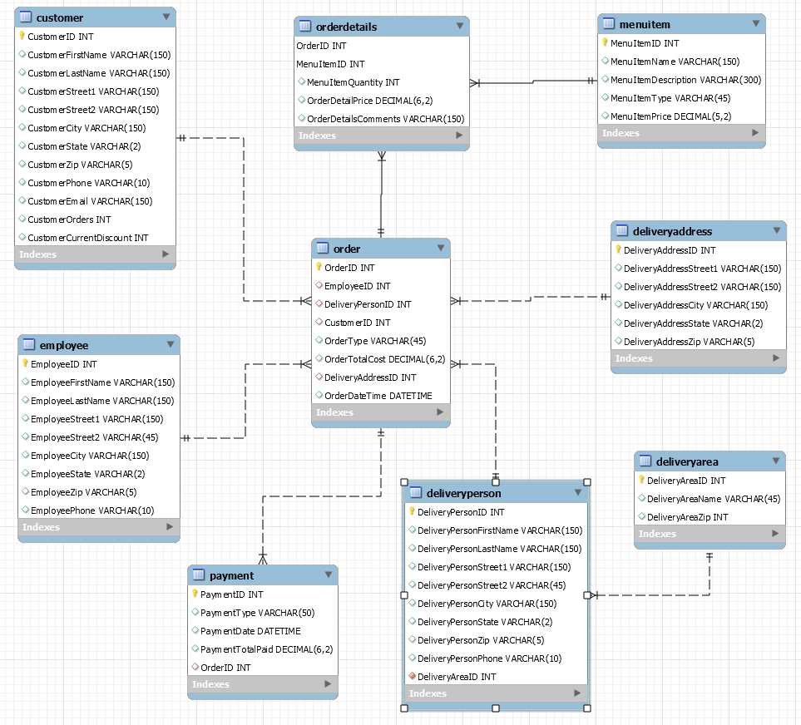
DB schema

Slide 9
DB design (key ideas + DB Demo)
10 relations show only “order to delivery” activities of a restaurant’s business.
Delivery address could differ from customer address.
Employees who deliver orders are separated from other employees because they participate in relationships that are unique.
One Zip Code can have multiple delivery areas.
OrderDetails is a transitional relation to avoid many-to-many relationship.

Slide 10
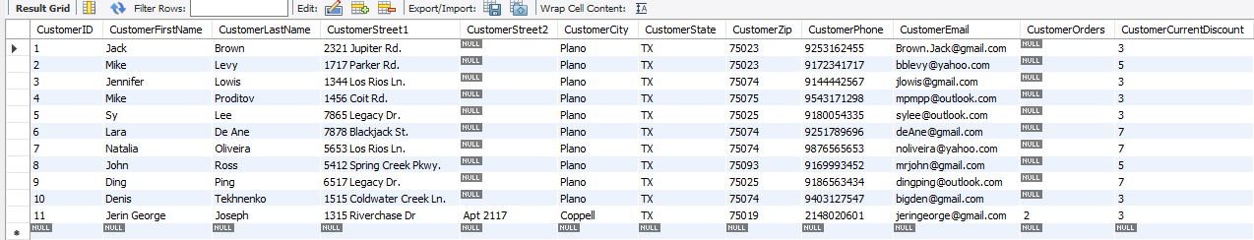
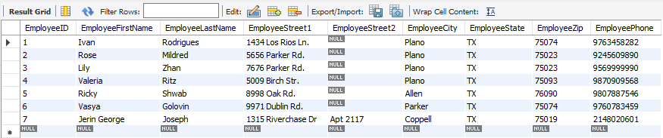
Database Design (Contd…)
Table: Customer
Table: Employee

Slide 11
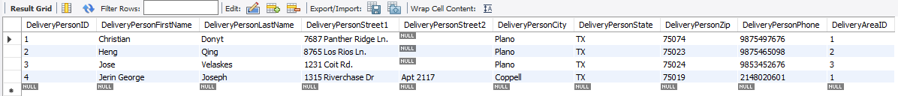
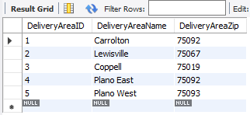
Database Design (Contd…)
Table: DeliveryPerson
The Delivery person details are maintained independently from the Employees.
Every delivery person is assigned to a delivery area, and to only one delivery area.
The Delivery areas are in a separate table called DeliveryArea
Table: DeliveryArea

Slide 12
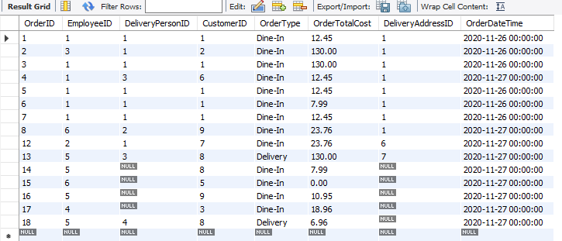
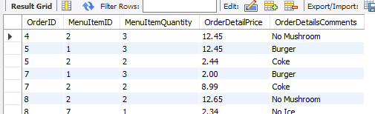
Database Design (Contd…)
Table: Orders
Details about the order are stored in the order table.
OrderDetails acts as the transitional table.
Table: OrderDetails

Slide 13
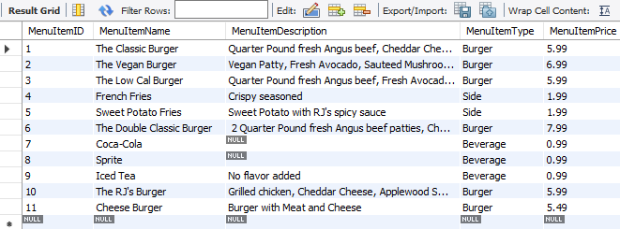
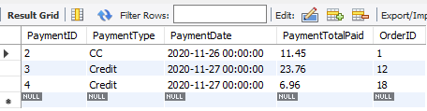
Database Design (Contd…)
The list of items in the menu is stored in the MenuItem table.
The price of each of items are stored in this table.
When the menu items are added to the order, the application uses this price to calculate the total amount for the order.
The Payment table holds the information on the payment.
Table: MenuItem
Table: Payment

Slide 14
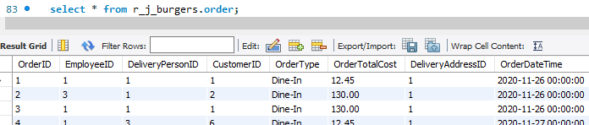
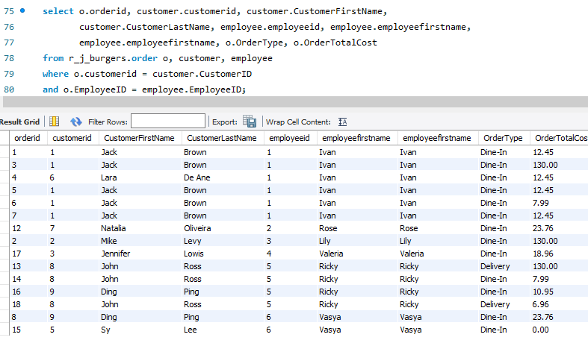
Queries - Order Retrieval
This query shows the order retrieval.
As shown in the first image, the order table only contains the ids for the customer and employee.
By performing an inner join on the Order, Customer and Employee table, additional information about the customer and employee is retrieved.

Slide 15
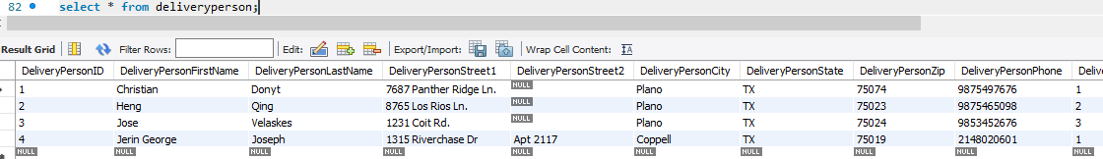
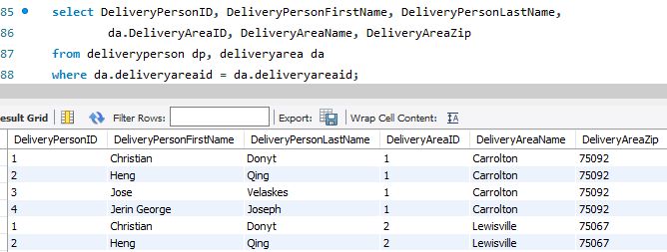
Queries - Delivery Person Details
The DeliveryPerson table contains only the deliveryAreaId.
The join query shown here to the right can be used to retrieve the delivery area associated with the delivery person.

Slide 16
Queries - Insert, Update & Delete Queries
INSERT INTO customer (CustomerFirstName,CustomerLastName,CustomerStreet1,CustomerStreet2,CustomerCity,CustomerState,CustomerZip,CustomerPhone,CustomerEmail,CustomerOrders,CustomerCurrentDiscount) VALUES ('George', 'Clooney', '1315 Riverchase Dr', 'Apt 2117', 'Coppell', 'TX', '75019', '2148020601', 'jeringeorge@gmail.com', 3, 3);
INSERT INTO employee (EmployeeFirstName, EmployeeLastName, EmployeeStreet1, EmployeeStreet2, EmployeeCity, EmployeeState, EmployeeZip, EmployeePhone) VALUES ('Brad', 'Pitt', '1313 Beverly Hills Dr', 'Suite 3', 'Carrollton', 'TX', '75092', '1133224455');
INSERT INTO r_j_burgers.order (EmployeeID, DeliveryPersonID, CustomerID, OrderType, OrderTotalCost, DeliveryAddressID, OrderDateTime) VALUES (5, null, 8, 'Delivery', 6.96, null, '2020-11-27');
delete from customer where CustomerID = 5;
delete from employee where EmployeeID = 4;
update customer set CustomerFirstName = 'Willaim',CustomerLastName = 'Lorenza',CustomerStreet1 = '690 Rosia St',CustomerStreet2 = 'Apt 922',CustomerCity = 'Ernestine',CustomerState = 'MP',CustomerZip = '87111',CustomerPhone = '8111138738',CustomerEmail = 'Willaim.Lorenza@gmail.com',CustomerOrders = 27,CustomerCurrentDiscount = 3 where CustomerID = 13;

Slide 17
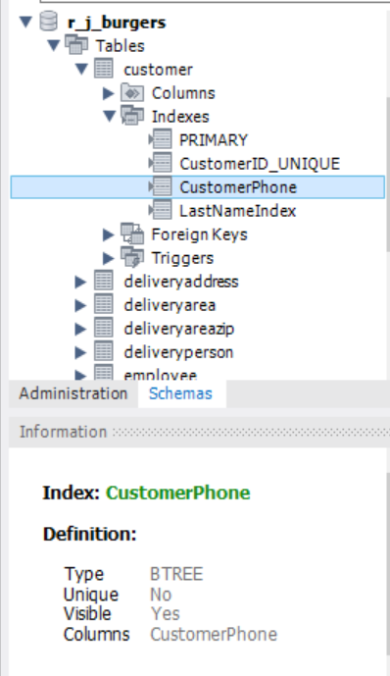
Database Normalization & Indexing
We have designed the tables in a such a way to avoid Multi-Valued Dependency. Hence 4NF Normalization was not required.
Hence the tables have been Normalized to BCNF.
Indexes were created wherever necessary.
Eg: Customer table CustomerPhone and CustomerLastName attributes. As this makes it easier to lookup a customer based on the phone number and lastname.
MySQL uses B-Tree indexes by default in most cases. B-TREE
Index was used in all our indexes.
Auto-Increment - MySQL supports the Auto-Increment feature.
Hence it was used to generate the primary keys for all the tables.

Slide 18
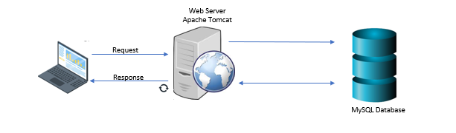
Application design
The application follows the MVC (Model - View - Controller) Architecture, where the model, controller and view is separated into distinct layers.

Slide 19

UI Demo
https://drive.google.com/file/d/1cJOlLIQSqj7TZr5ARtVHt1hfwc-gADee/view?usp=sharing

Slide 20
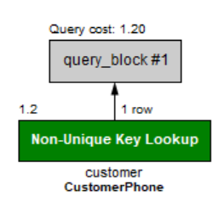
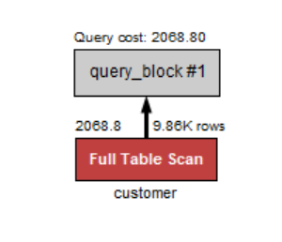
Analysis - Part 1 - Speed
We had created indexes to improve the speed of the application.
To analyze the performance of the queries, we inserted 10,000 rows into the customer table.
Then we queried the database using and ignoring the index.
Index Used
Index Not Used
select * from customer
where CustomerPhone = "9172341717";
select * from customer
ignore index (CustomerPhone)
Where CustomerPhone = "9172341717";
Query returned fast: 0.015 Secs
Query cost is very low.
The query scanned only one row, because the index was used
Query was much slower: 0.031 Secs
Query cost is very high.
The query scanned the entire table (9.86k rows)

Slide 21
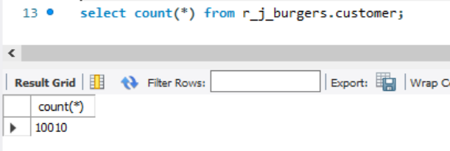
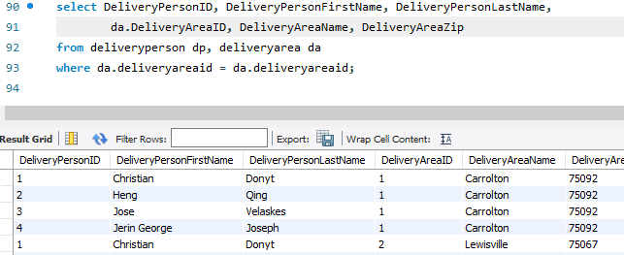
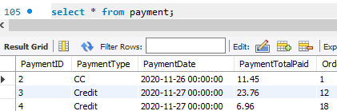
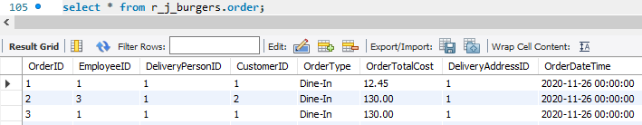
Analysis - Part 2 - Accuracy
The below queries show the accuracy of the database. The accuracy was also manually validated.
As shown below, we maintained the same date format across the application to maintain accuracy

Slide 22
Analysis - Part 3 - Challenges
What challenges did we face in the development process?
Lack of raw data - To test the performance of the indexes and the query plans, we did not have enough data to perform the test.
Some technical issues during the design process:
Database schema must have unique names for constraints
The table name is ORDER which is a keyword.
Faced some access issues because the user id used did not have the grants to create tables.
How did we overcome those?
Lack of raw data - We created an utility program to insert 10,000 rows into the customer table to setup the data for testing.
To avoid the ORDER Table name clash with the keyword, we used the table name along with the schema as “r_j_burgers.ORDER”.
Used documentations to resolve technical issues.

Slide 23
Analysis - Part 4 - Limitation & Future
What are the limitations of the project?
The application does not have an authentication mechanism, it can be included.
The application does not allow the tip feature which is very important for American restaurants.
The application is currently hosted locally on our computer, the application can be deployed in the cloud and be open to the internet, so that multiple users can use it.
Path to future work?
Extend database with integrations to payment processors
More customer data, more orders’ records and hence optimize the application to handle higher volume.

Slide 24
References
Database System Concepts (Seventh Edition) by Avi Silberschatz, Henry F. Korth, S. Sudarshan;McGraw-Hill
Database Systems: Design, Implementation, & Management (13th edition) by Carlos Coronel, Steven Morris
MySQL Workbench - https://dev.mysql.com/doc/workbench/en/
MySQL Indexes - https://dev.mysql.com/doc/refman/8.0/en/mysql-indexes.html

Slide 25
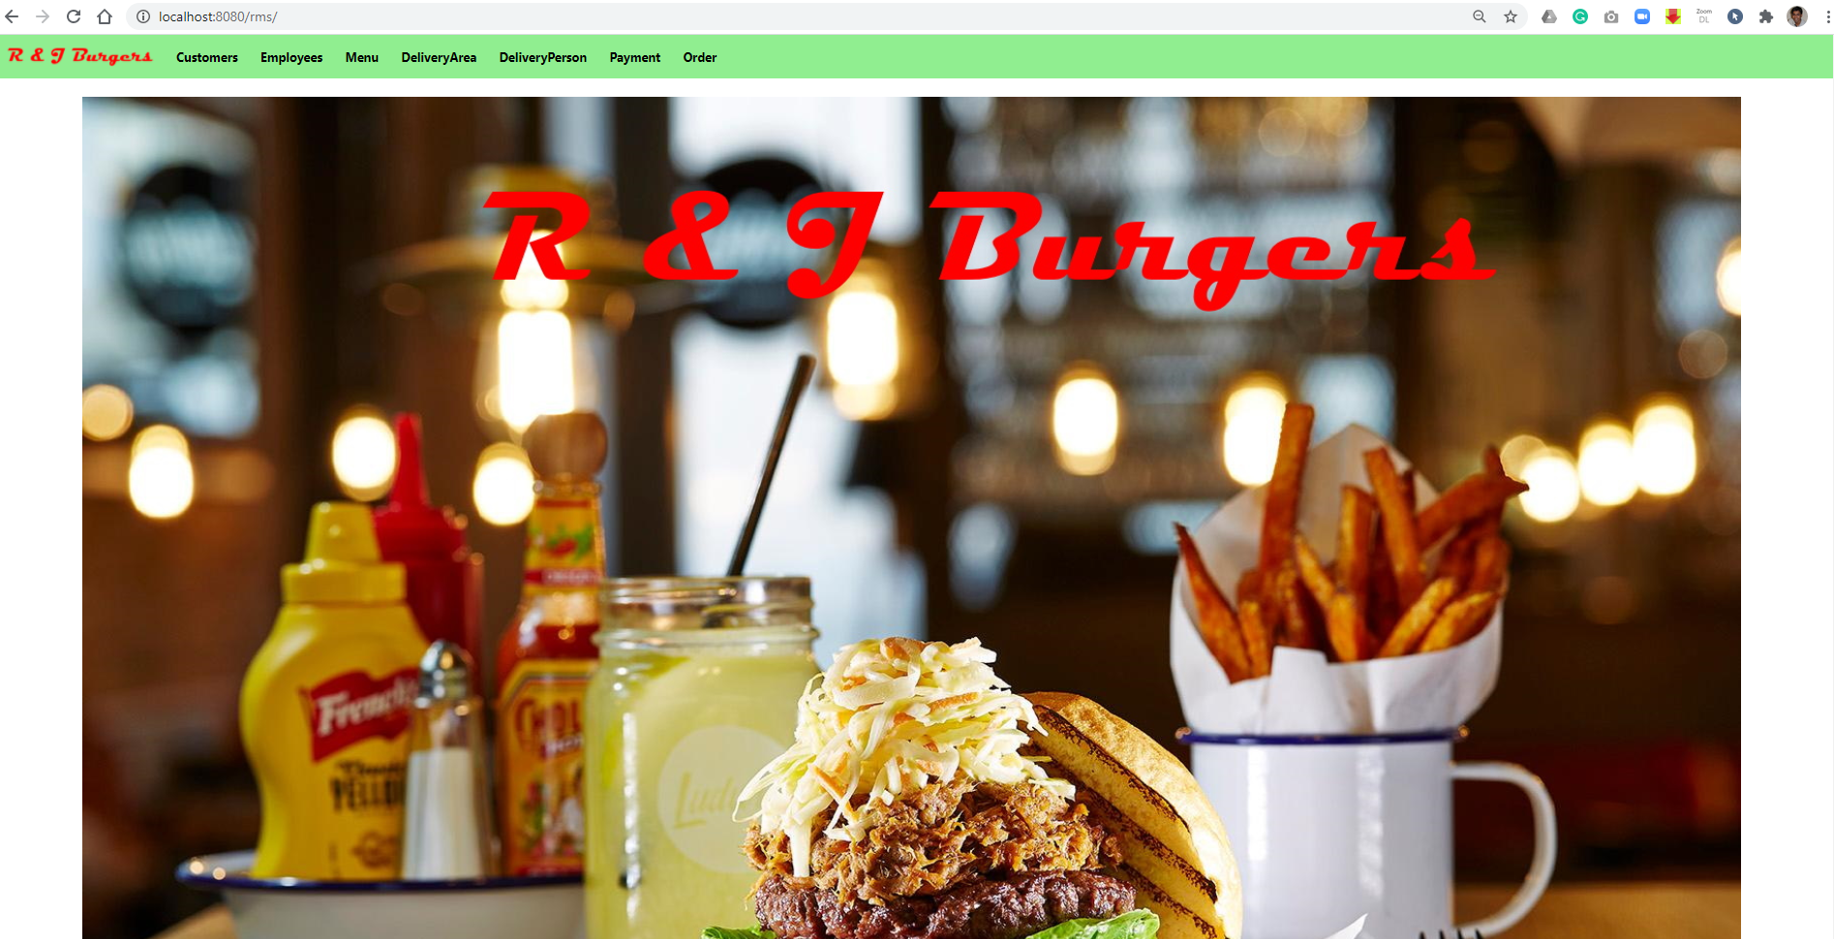
Appendix A - UI Screenshots - Homepage

Slide 26
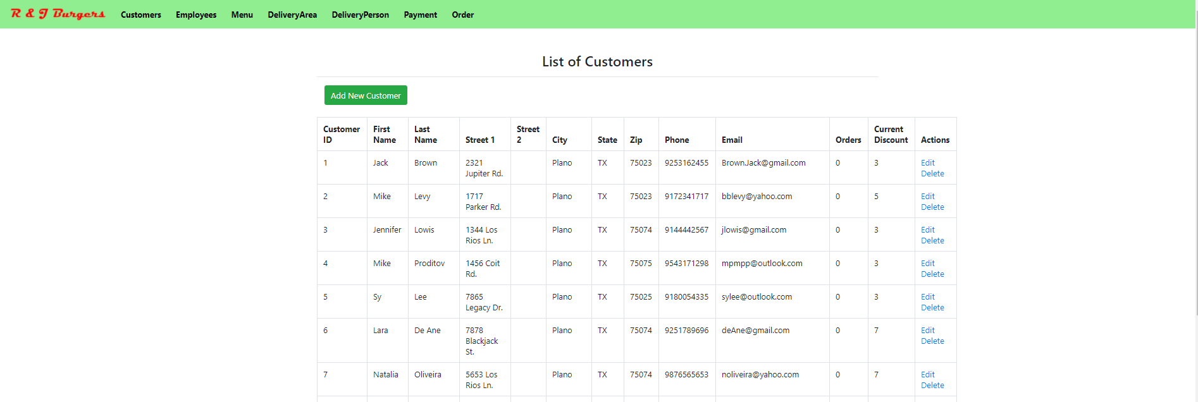
Appendix B - List of Customers Screen

Slide 27
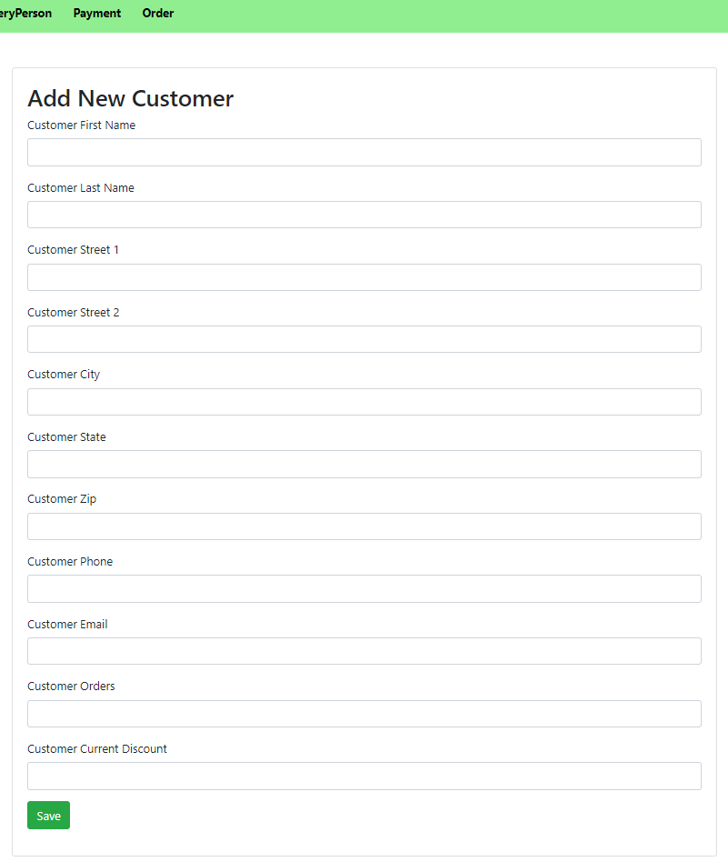
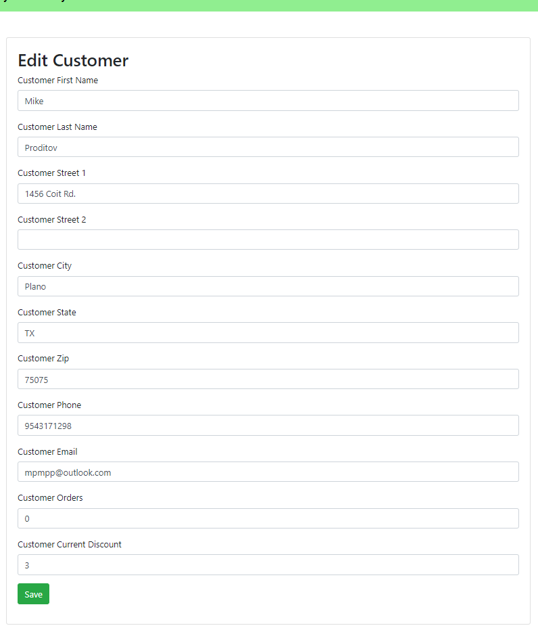
Appendix C - Add & Edit Customer

Slide 28
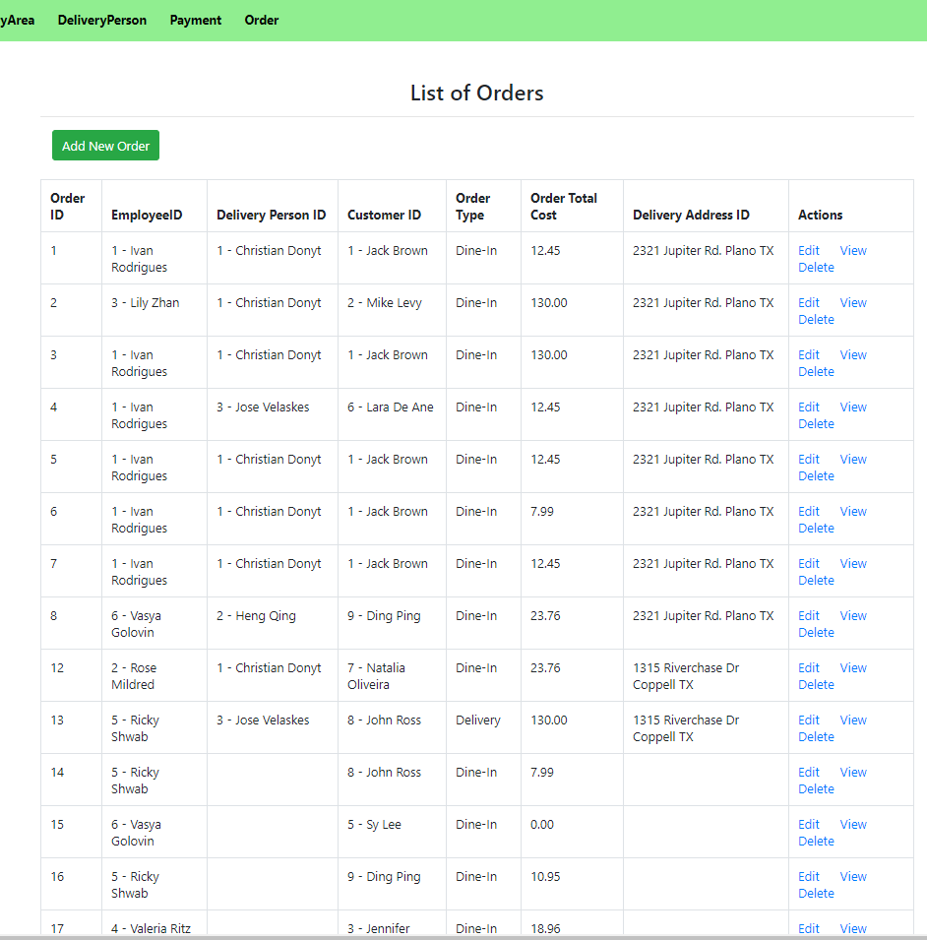
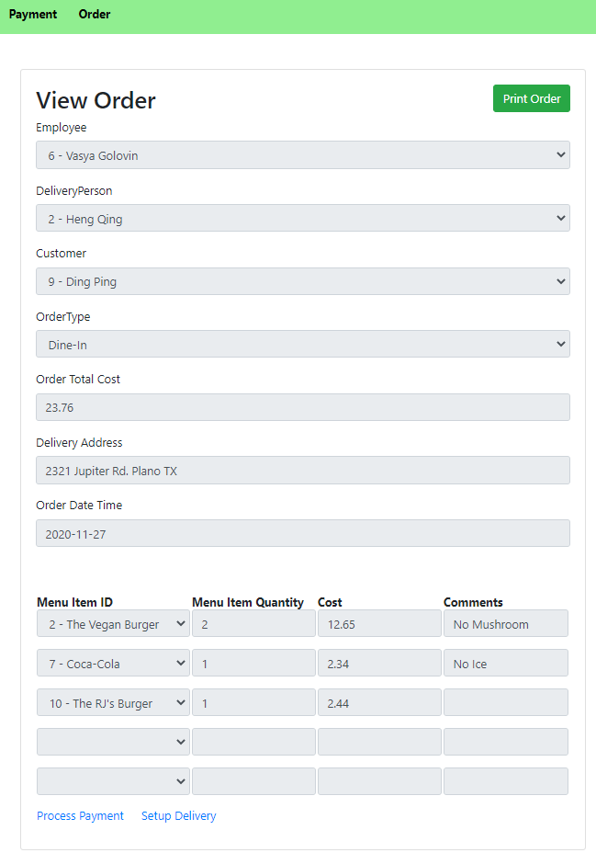
Appendix D - List of Orders & View Order

Slide 29
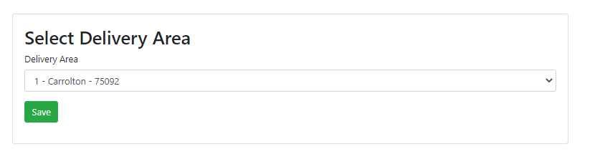
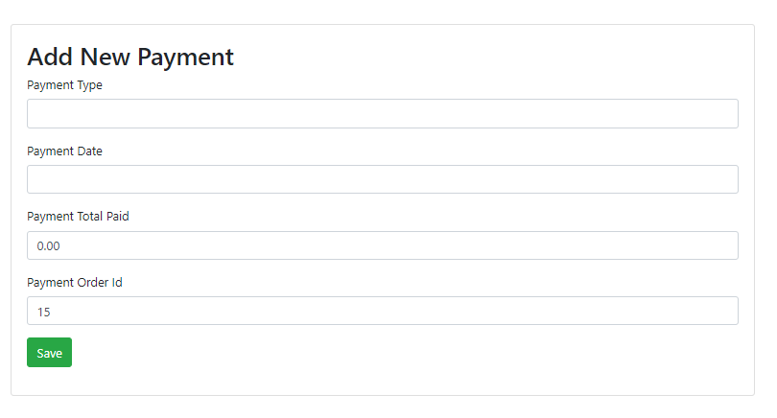
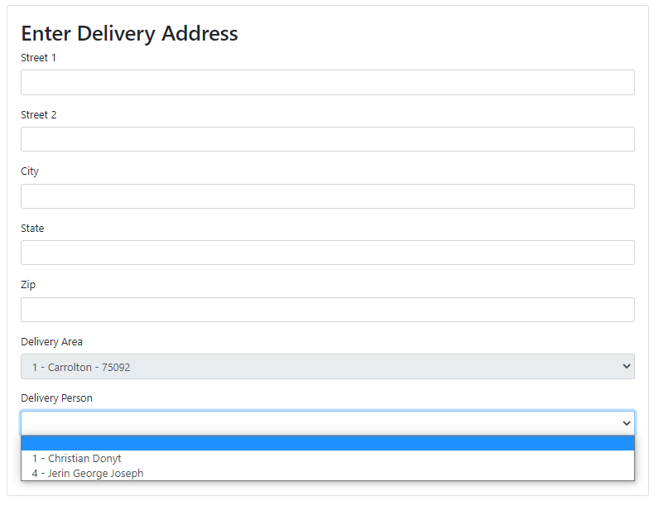
Appendix E - Delivery Area and Payment

